Slide 1

Diabetes classification using machine learning - Data Splitting and Model Building
Summer Project Team 10
Pruthiev AS 2019506067
Notes:
NOTE:
To change the image on this slide, select the picture and delete it. Then click the Pictures icon in the placeholder to insert your own image.

Slide 2
DATA SPLITTING
Data Splitting involves dividing the data for training and testing purpose
The machine learning model learns from the training data and then classifies the testing data accordingly
The testing data is used to test the trained or validated model. The testing data result and the tested data result(from our Machine learning model) are compared to evaluate our model.
The Decision Tree Classifier algorithm builds the decision tree with the help of the training data. The testing data can be applied on that tree which classifies accordingly.
Naïve Bayes similarly creates a Multilevel dictionary by storing the probability of each class along with features using the training data .The testing data is then applied and classifies the classes which gives maximum probability among the classes

Slide 3
Data splitting - Algorithm and Data structure
ALGORITHM
STEP 1 : We split the given dataset into training data and testing data with help of the skearn library under model_selection function train_test_split(input_features , outcome) is used
STEP 2 : By default, this functions splits the data as Testing Data : 75% and Training Data : 25%
STEP 3 : train_test_split() function return four list X_train , X_test , Y_train , Y_test,
X_train – training dataset with input / independent variables
X_test – testing dataset with input/independent varaibles
Y_train – training dataset with output / dependent varaibles
Y_test – Once we predict / classify the X_test we compare with this to check the performance of the model
DATA STRUCTURE FOR SPLITTING :
1 ) List 2 )DataFrame in pandas

Slide 4

MODEL BUILDING
DECISION TREE CLASSIFIER :
The decision tree classifier comes under supervised machine learning model that can be used for prediction and classification(Binary or multiclass classification) problems. A decision tree is built top-down from a root node and involves partitioning the data into subsets that contain instances with similar values (homogenous).
Deciding which feature to split the tree depends on :
1 ) Gini Index 2 )Entropy 3) Information Gain
GINI INDEX :
The gini index calculates the amount of probability of a specific feature that is classified as incorrectly
The gini index formula is given Gini Index = 1 – $\sum_{i}^{c}{(pi}$)²
P_{i} - Probability of i^{th} class = $\frac{no. of the elements of ith class}{total number of elements}$
The average is given by
$\frac{no. of elements in left node}{no. of elemets in the parent node}$ $∗ Gini_index(Left_node)$ + $\frac{no. of elements in right node}{no. of elemets in the parent node}$ $∗Gini_index(Right_node)$

Slide 5

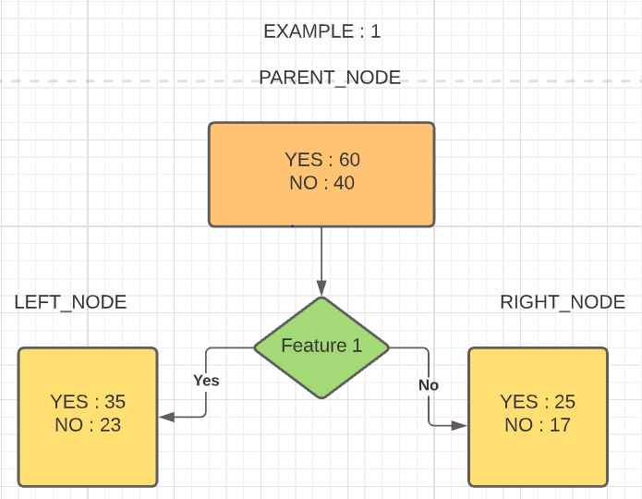
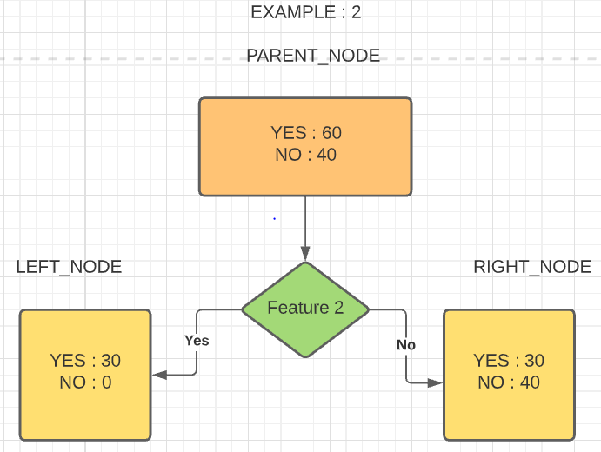
MODEL BUILDING Decision Tree Contd.
Consider a problem in which the output is to classify the input variable to any one of the classes Yes , No.Initially the outcome values are as shown in parent node
EXAMPLE : 1
The gini index of the left node = 1 – ((35/58)² + (23/58)²) = 0.49
The gini index of the right node = 1 – ((25/42)² + (17/42)²) = 0.49
The average in Example 1 is = (58 / 100) *0.49 + (42/100) * 0.49 = 0.48
EXAMPLE : 2
The gini index of the left node = 1 – ((35/58)² + (23/58)²) = 0.49
The gini index of the right node = 1 – ((25/42)² + (17/42)²) = 0.49
The average in Example 2 is = (30 / 100) *0 + (70/100) * 0.48 = 0.33
By comparing the gini index by splitting the tree with feature 1 and feature 2 ,splitting the tree with feature 2 is better as the impurity is less when compared to feature 1

Slide 6

MODEL BUILDING – Decision Tree Contd.
Entropy:
The entropy gives the measure of uncertainity , disorder , impurity in a node
The entropy is given by the formula Entropy = $−\sum_{i}^{c}{(pi}$ * log(pi))
P_{i} - Probability of i^{th} class = $\frac{no. of the elements of ith class}{total number of elements}$
The summation goes on for c number of classes
The average is given by ,
$\frac{no. of elements in left node}{no. of elemets in the parent node}$ $∗Entropy(Left_node)$ + $\frac{no. of elements in right node}{no. of elemets in the parent node}$ $∗Entropy(Right_node)$
Information Gain :
The information gain is based on the decrease in entropy after a dataset is split on an attribute. Constructing a decision tree is all about finding attribute that returns the highest information gain (i.e., the most homogeneous branches).
Maximizing (Entropy_before_split – Entropy_After_split) is information gain as we are going towards more pure or homogeneous nodes. The information gain = E_{(old)} – E_{(new)}

Slide 7
MODEL BUILDING Decision Tree Contd.
Considering the same example
EXAMPLE : 1
The entropy of the left node is = - 35/58 * log(35/58) – 23/58 * log(23/58) = 0.96
The entropy of the right node is = -25/42 * log(25/42) - 17/42 * log(42) = 0.97
The average entropy in Example 1 is = (58 / 100) *0.96 + (42/100) * 0.97 = 0.96
EXAMPLE : 2
The entropy of the left node is = - 30/30 * log(30/30) – 0/30 * log(0/30) = 0
The entropy of the right node is = -30/70 * log(30/70) - 40/70 *log(40/70) = 0.98
The average entropy in Example 2 is = (30 / 100) *0 + (70/100) * 0.98 = 0.68
The Entropy before the split is = -60/100 * log2(60/100) – 40/100 * log2(40/100)
= 0.97
The information gain in Example 1 is = 0.97 – 0.96 = 0.01
The information gain in Example 2 is = 0.97 – 0.68 = 0.29
Thus, splitting the tree with feature 2 is the best split as we gain more information when compared with splitting with feature 1

Slide 8
Decision Tree - Algorithm and Data structure
ALGORITHM :
STEP 1 : Import the library DecisionTreeClassifier from sklearn.tree
STEP 2 : Create an instance of the class DecisionTreeClassifier as decisionTree
STEP 3 : Train the model using the fit function which accepts two parameters X_train , Y_train.
STEP 4 : Classify the data using the predict function which accepts a X_test as paramter and store in y_pred_decision_tree to compare it with Y_test
DATA STRUCTURE :
1 ) List 2 )DataFrame in pandas

Slide 9

MODEL BUILDING
Naïve Bayes Classifier:
Naïve Bayes classifier is probabilistic based machine learning algorithm which works based on Bayes theorem
Bayes theorem states that probability of dependent event is given by
P(A | B) = $\frac{P\left(B \right|A) ∗P(A)}{P(B)}$
P(A | B) – is a conditional probability that the event A occurring given that event B has already occurred
P(B | A) - is a conditional probability that the event B occurring given that event A has already occurred
P(B) , P(A) are the probabilities of event A , B occurring independently each other
In general ,suppose there are n features independent variable(features) denoted by X and the outcome varaible denoted by Y and there are k different classification then,
P(Y = ai | X = x) = $\sum_{i=1}^{k}{\frac{P\left(X=x \right| Y=ai) ∗ P\left( Y = ai\right)}{P(X = x)}}$
P(Y = ai) = $\frac{Number of values that comes under ai class in dependent varaible}{Total number of values in the dependent varaible}$

Slide 10

MODEL BUILDING
Naïve Bayes Classifier:
To find P(X = x) is why it called as Naïve Bayes
The Naïve Bayes is Naïve because it makes a strong assumption that all the features are independent of each other
The probability of independent events say P(A ∩ B) = P(A) *P(B)
Thus we apply the same to the term P(X = x) it becomes as
P(X = x) = (P(X = x_{i}¹ | Y = a_{j}) * P(x = x_{i}² | Y = a_{j}) ……* P(x = x_{i}^{N} | Y = a_{j})) * P(Y = a_{j})
X_{i} denotes the i^{th} data point and X^{n}_{i} denotes the nth feature in i^{th} data point in the dataset
We can remove the denominator as it a constant value for all the i data points in the dataset
P(y = ai | X = x) = $\prod_{i=1}^{n}{P\left(x=xi \right|Y=ai)∗P(Y=aj)}$
where j refers to the j the classification class and ranges form 1 to k classes
P(X = xi | Y = aj) = $\frac{Number of values in the data set that holds\left( x = xi \& y = aj\right)True}{Number of values in the that hold y=ai true}$

Slide 11
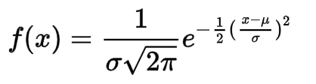
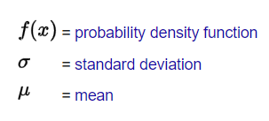
MODEL BUILDING
Naïve Bayes Classifier:
Since it deals with probability the data should be distributed thus it follows a Gaussian Distribution given by

Slide 12
Naïve Bayes - Algorithm and Data structure
ALGORITHM :
STEP 1 : Import the library GaussianNB from sklearn.naive_bayes
STEP 2 : Create an instance of the class GaussianNB as naïve_bayes
STEP 3 : Train the model using the fit function which accepts two parameters X_train , Y_train
STEP 4 : Classify the data using the predict function which accepts a X_test as paramter and store in y_pred_naive_bayes to compare it with Y_test
DATA STRUCTURE :
1 ) numpy array 2 )DataFrame in pandas

Slide 13
THANK YOU
SUMMER PROJECT TEAM – 10

